Slide 1

Dojo Widgets
  Dijit: A widget reuse library

Slide 2

What is Dijit ?
Dojo provides a rich library of Ajax enabled widgets which is ready to use: Dijit.
In order to know which widgets are provided you either play with the demo or read the documentation (too many widgets to cover in a course).
Always check to see if Dojo has a widget before rolling your own (even for a button..)‏

Slide 3
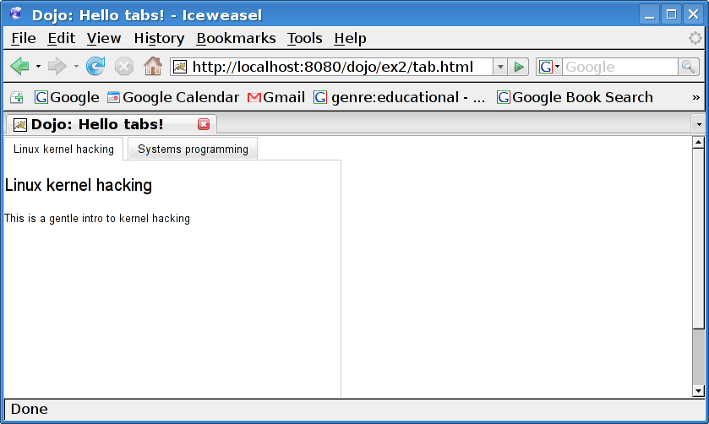
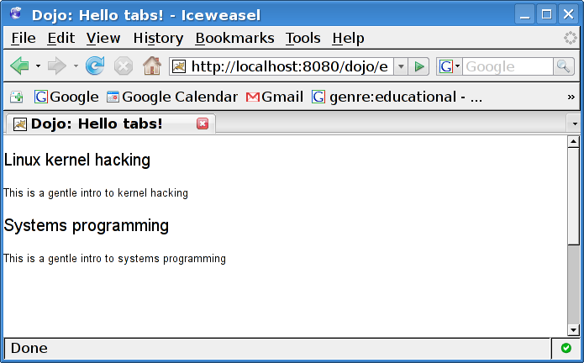
Graceful degradation
What if your client does not have JavaScript enabled in their browser? Lets try it out..

Slide 4
Graceful degradation
Other weird things happen. For instance, a date picker becomes a text box.
This is called “graceful degradation” and is some consider this to be a strength of Dojo.
I do not. It does not provide the application you want.
This means your clients will need Javascript enabled to use your application.

Slide 5
Using Dojo widgets
dojo.require(“[package and widget name”]); - usually at the <head>.
Use the widget somewhere in your HTML (declarative style).
Use the widget somewhere in your Javascript code (programmatic style).
To get your widget by id use (prog style):
  var w = dijit.byId("ok1");

